Slide 1
THE TALE OF TWO GREAT CRISES
Michele Fratianni* and Federico Giri**
*Indiana University, Università Politecnica delle Marche and MoFiR, email:fratiann@indiana.edu
**Università Politecnica delle Marche, email:f.giri@univpm.it

Slide 2
The Great Depression (GD) and the Great Financial Crisis (GFC) have not only been colossal and worldwide events, but have challenged our “consensus” view of economics and forced policymakers to adopt, at times improvising, new strategies.
We revisit these two great events with a comparative exercise that focuses on critical similarities and differences.
The comparative exercise will be based on two statistical universes: an aggregate of 14 industrial countries (the “world”) and a group of five significant countries -- the United States, the United Kingdom, Germany, France and Italy.

Slide 3
THE QUESTIONS
Monetary policy: what role in triggering and exacerbating the recessions?
Sudden stops in capital flows: what role in precipitating quick and sharp macro adjustments in the fixed exchange rate regime (gold-standard and the Eurozone)?
Hume’s price-specie flow mechanism: was it functioning properly, not only in the 1930s, but also in the Eurozone?
International cooperation: did it fail to prevent a deflationary bias by forcing asymmetric adjustments on deficit countries?
Banks: were they cause or victims of the crises? Link to the money supply process?
Financial liberalization and innovation: facilitators of credit boom and bust?
What have central bankers learned from the GD?

Slide 4
ANTECEDENTS
Modern times
US monetary policy very accommodating after East Asia crisis and dot-com bubble.
In 2002, starts “Greenspan put” and housing boom.
From 2001 to 2006, US soaked up $3,573 billions of world capital flows
A switch occurred at the start of 2006.
Reason: US monetary authorities feared a “Japanese scenario” and world “saving glut” (Bernanke 2005).
ECB mimicked Fed actions with a two-year lag.

Slide 6
In the 1920s
Return to gold convertibility: Germany (1924), UK (1925), Italy (1927), France (1928)
France
Started restrictive monetary and fiscal policies in 1926 with a view to return to gold.
Big capital and gold inflows followed (1928-1932)…France a safe heaven.
No monetary expansion with gold inflows, in violation of Hume price-specie flow mechanism.
Money tightness in the world went up more in 1928 when US monetary policy turned restrictive.

Slide 7
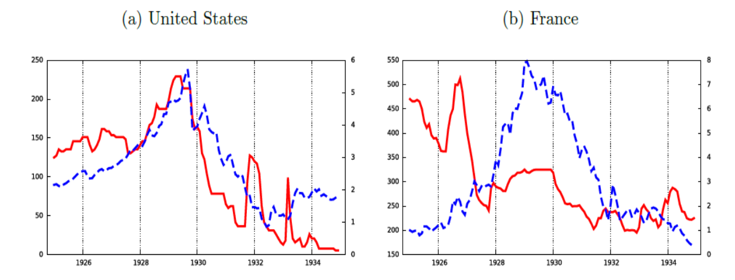
Private discount rate and stock price index, 1925-1935

Slide 8
Motivations for US actions: capital outflows and stock market (Hamilton 1987).
From 1924 to 1928, US net capital outflows ≈ $4 bn, much going to Germany
Close parallel: Germany of 1928 and the Eurozone South of 2008-2009.
In 1928, Germany stuck to the gold standard, deflated the economy and went into a deep recession.
In 2008-2010, the Eurozone South stuck to the FIX, deflated the economy and went into a recession.
In both cases, international cooperation would have resulted in a better outcome, but it did not happen.

Slide 9
Net capital flows in the 1920s and 1930s

Slide 10
Net capital flows and long-term interest rates, EU, 1995-2015
In sum, monetary policy was a critical trigger for both the GD and GFC.

Slide 11
The Depression Years
World per capita real GDP growth, based on an aggregate of 14 countries, 1900-2014.

Slide 12
The annual average, over the 114 years, is 2.6 per cent.
Six periods when growth is negative: WWI, WWII, and four peace-time periods.
  Biggest drop is in 1944-46 (-29 percentage points)
  followed by the GD of 1930-33 (-17.9 percentage points),
  followed by WWI period, 1917-19 (-6.1 pp),
  followed by 1914 (-6 pp),
  followed by the GFC of 2009 (-4.4 pp), and
  lastly by 1908 (-2.9 pp).
Based on this statistics alone, the GD rates as a bigger shock than the GFC.

Slide 13
World inflation rate (CPI), 1900-2014.

Slide 14
The annual average is 1.5 per cent.
Two periods of canonical deflation:
  1921-1922 (-6.5 pp), and
  1927-1933 (-12.5 pp).
In 2009 (depression year of the GFC), the inflation rate dropped to zero.
Again, the negative shock of the GD, measured in terms of deflation, was much bigger than the GFC’s.

Slide 15
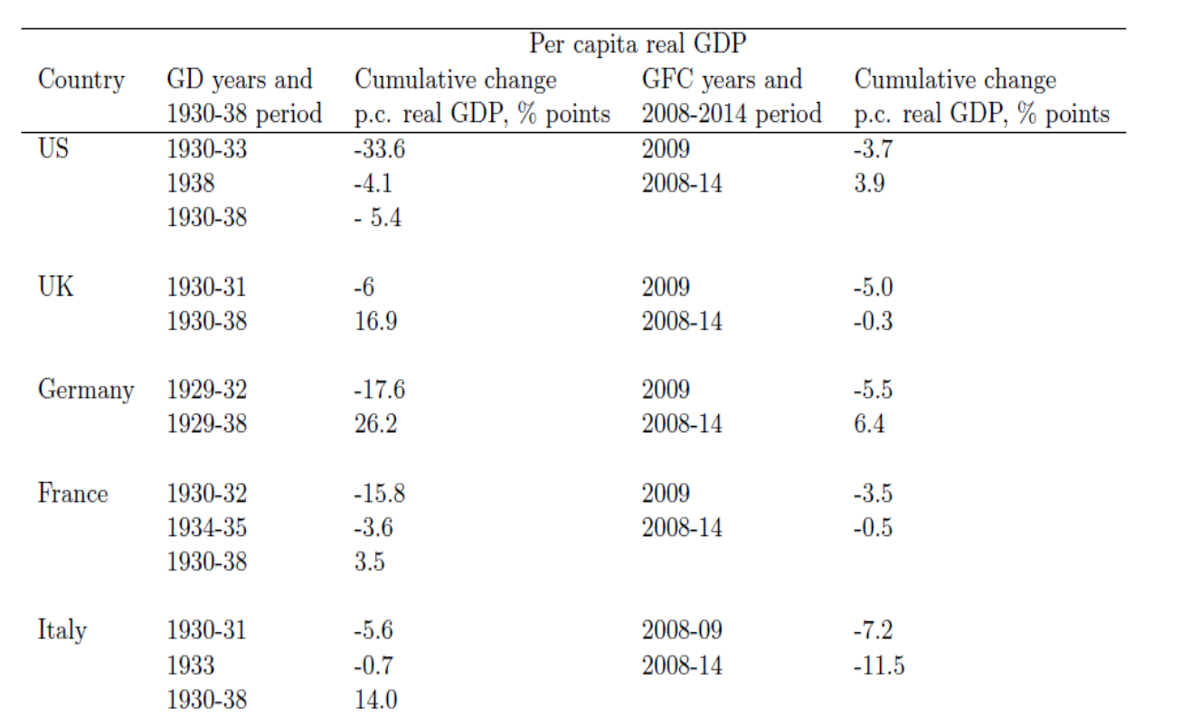
Growth of p.c. real GDP for our sample of five countries

Slide 16
THE LIMITS OF THE FIX
The 1922 Genoa Conference: gold to be supplemented by foreign exchange reserves.
Credibility of the gold parity? Same story as in Bretton Woods (Triffin 1960).
Gold the scarce money and Gresham’s Law.
International cooperation could have prevented the scramble for gold.
Leadership was a scarce resource (Nurkse 1944; Clarke 1967; Eichengreen 1995).
France a prime example of Gresham’s law: she delivered the coupe de grâce to the standard and added “the pressure of deflation in the rest of the world” (Nurkse 1944).
Irwin (2010) is bolder and titles his paper, “Did France cause the Great Depression?”.

Slide 17
Regardless of the role one may give to any given country in contributing to the GD, the asymmetric adjustment to external imbalances stands out.
The rules of the game called for symmetry of adjustment. In practice, adjustment fell disproportionately on deficit countries.
In sum, without international cooperation, the gold exchange standard acted as a straitjacket on monetary expansion. It imparted a deflationary bias to the system.

Slide 18
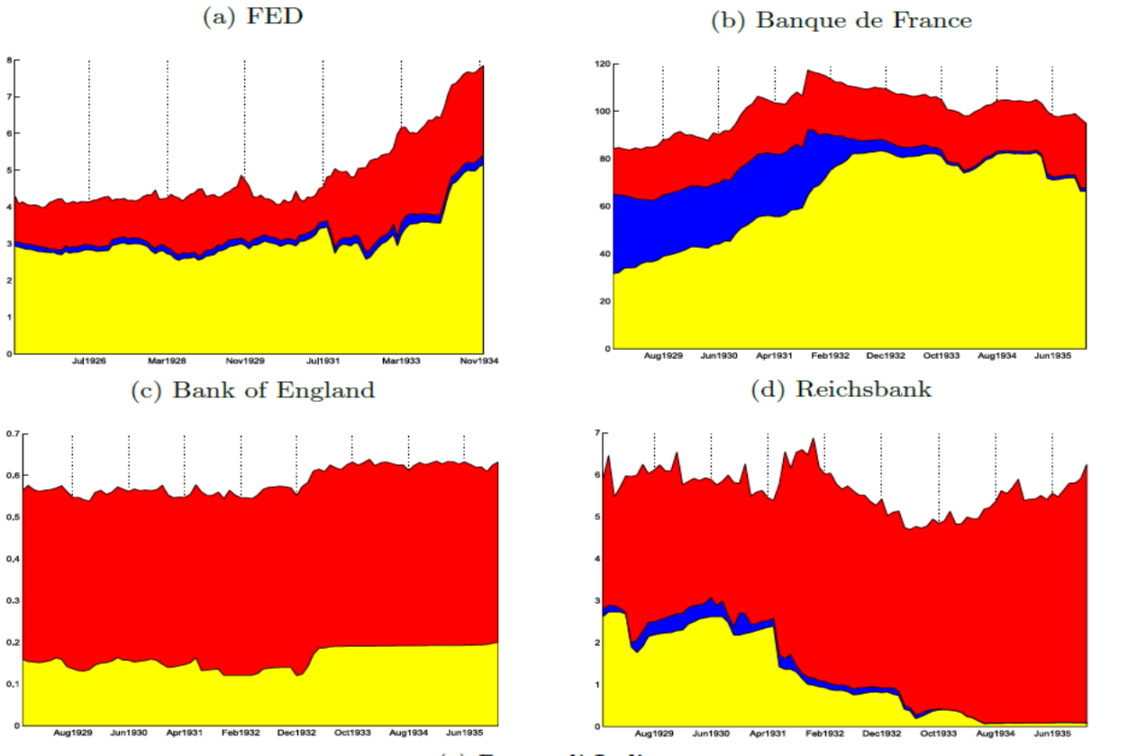
Central banks’ assets, 1925-1935
Yellow=gold, blue=forex, red= domestic

Slide 19
Parallels with the Eurozone
The Eurozone is a “strong” fixed exchange rate arrangement.
The gold-exchange standard was also a fixed exchange arrangement.
Both the Eurozone and the gold standard share a lack of a fiscal union.
  Other similarity is the faulty price-specie flow mechanism.
  See the graph of CA imbalances of the North and the South of the EZ.
South has an excess of domestic absorption over domestic production (from 1999 to 2012) and a consistently higher inflation rate of inflation than Germany.
Price-specie flow mechanism would have predicted net flows of money and credit to move to CA-surplus and low inflation Germany. Not the case.

Slide 20
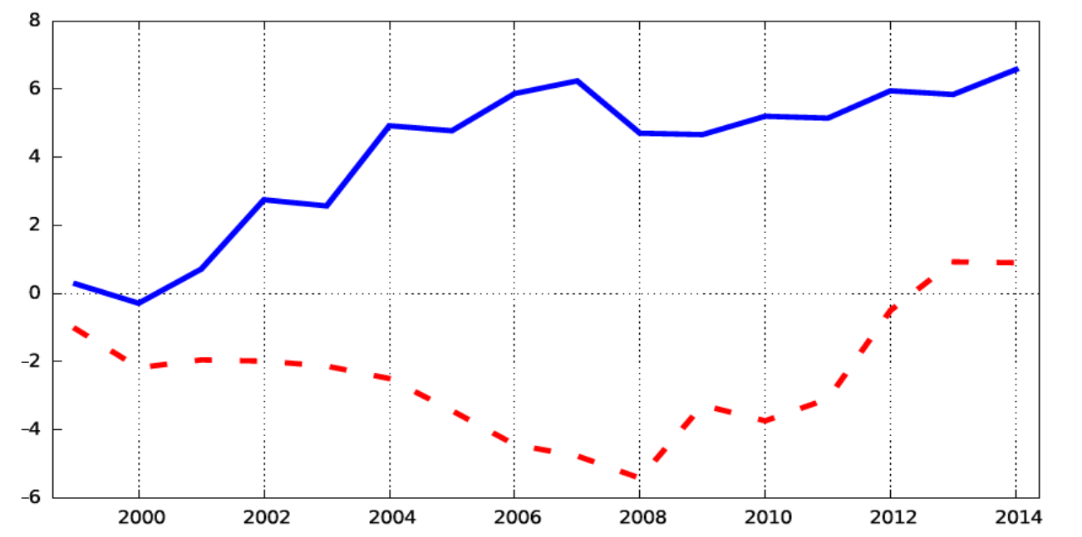
Current-account balance as a percent of GDP, North vs. South of the EZ, 1999-2014
Blue = North (Austria, Belgium, Finland, Germany, and the Netherlands);
dashed = South (Greece, Italy, Portugal and Spain).

Slide 21
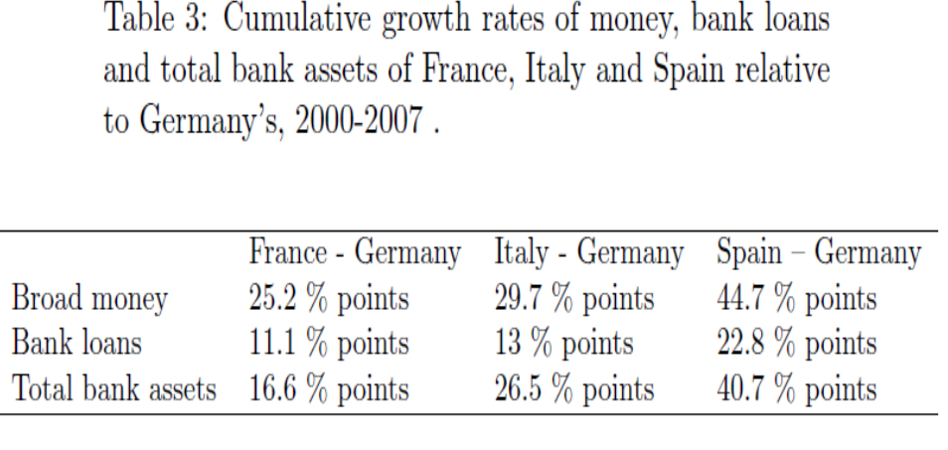

Slide 22
Other similarity: importance of capital flows to finance CA deficits.
We have seen the 2008-2010 sudden capital flow stops (like in 1928).
In 2008-2010, South kept the FIX and was forced to a rapid correction of its CA deficit while facing rising sovereign yield spreads (Alessandrini et al 2014).
Final similarity: asymmetric adjustment to CA imbalances. Resulting from:
  a neglect of setting limits on members’ current-account imbalances, and
  refusal of the North to accept burden sharing, which calls for adjustment to fall predominantly on surplus countries when economic activity is slack and predominantly on deficit countries when conditions are inflationary (Keynes 1943; Mundell 1968).

Slide 23
BANKS AND MONEY
In the 1930s, banking crisis occurred after output implosion; in the GFC, the sequence was opposite; in both cases, they had a big impact on the real economy.
Bank failures in the 1930s were common occurrence, with some notable exceptions like the UK and Canada. The US had the lion’s share of these failures.
One important aspect of bank failures is their impact on the money supply (Friedman and Schwartz 1963). We omit here the credit channel (Bernanke’s 1983).
In the pre-deposit-insurance period, banks’ troubles fuelled fears in the public that “…means of payment will be unobtainable at any price and, in a fractional-reserve banking system, leads to a scramble for high-powered money” (Schwartz 1986:11).

Slide 24
This translates into a rise in the currency-to-deposits ratio (k). Deprived of liquid funding, banks liquidate their non-marketable assets, whose prices fall. Bank insolvencies follow, further raising the k ratio. This is the reason k is taken a thermometer of a banking crisis (Bernanke and James 1991).
Surviving banks react to uncertain environment by raising their reserve-to-deposit ratio (r).
The end result is a collapse of the money multiplier and, in the absence of a compensatory change in the monetary base, a collapse of the money stock.

Slide 25
The US story is well-known and have led Friedman and Schwartz to call it a major policy failure, based on the assumption that monetary authorities were aware of the relationship between the monetary base, the multiplier and its determinants.
The German money stock and its underlying factors behaved qualitatively like the US counterparts (James 1984). Here too we have a major policy failure.
France followed Germany but with a lag. Starting in 1931, the Banque de France refused to accommodate gold inflows with an expansion of the monetary base.

Slide 26
The UK story is different from US, German, and French experiences. The monetary base and money remained stable until 1932 and then exploded, a consequence of having abandoned god convertibility (1931).
The Italian experience is closer to the UK than to the other three countries, despite the country’s formal commitment to gold. The decline in the Italian money stock was very moderate and so was the rise in k, mostly because Mussolini handles the big banking crises in total secrecy. The Banca d’Italia was also very active as a lender of last resort. The end result was that the monetary base almost compensated the moderate decline in m (Fratianni and Spinelli 2004).

Slide 27
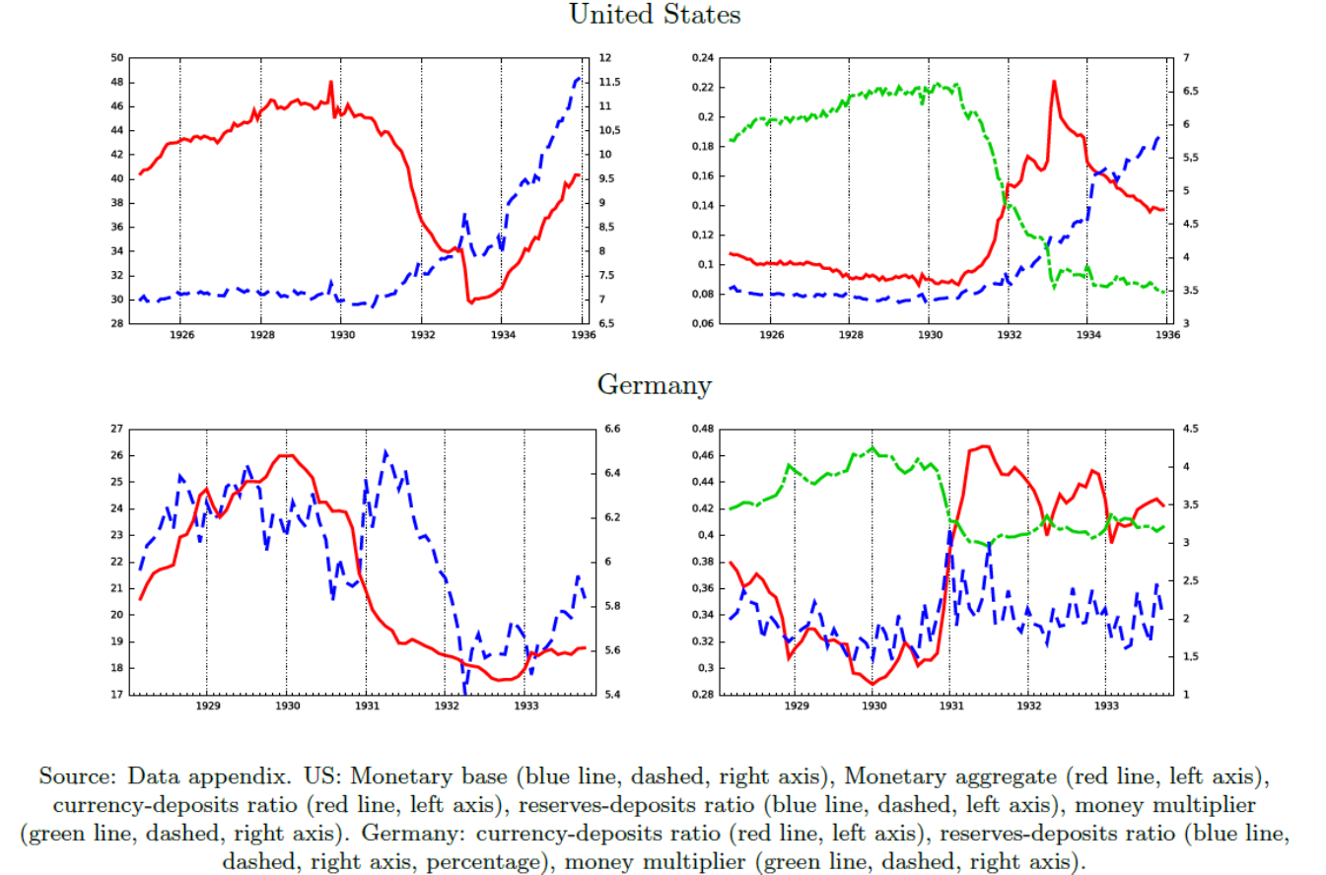

Slide 28
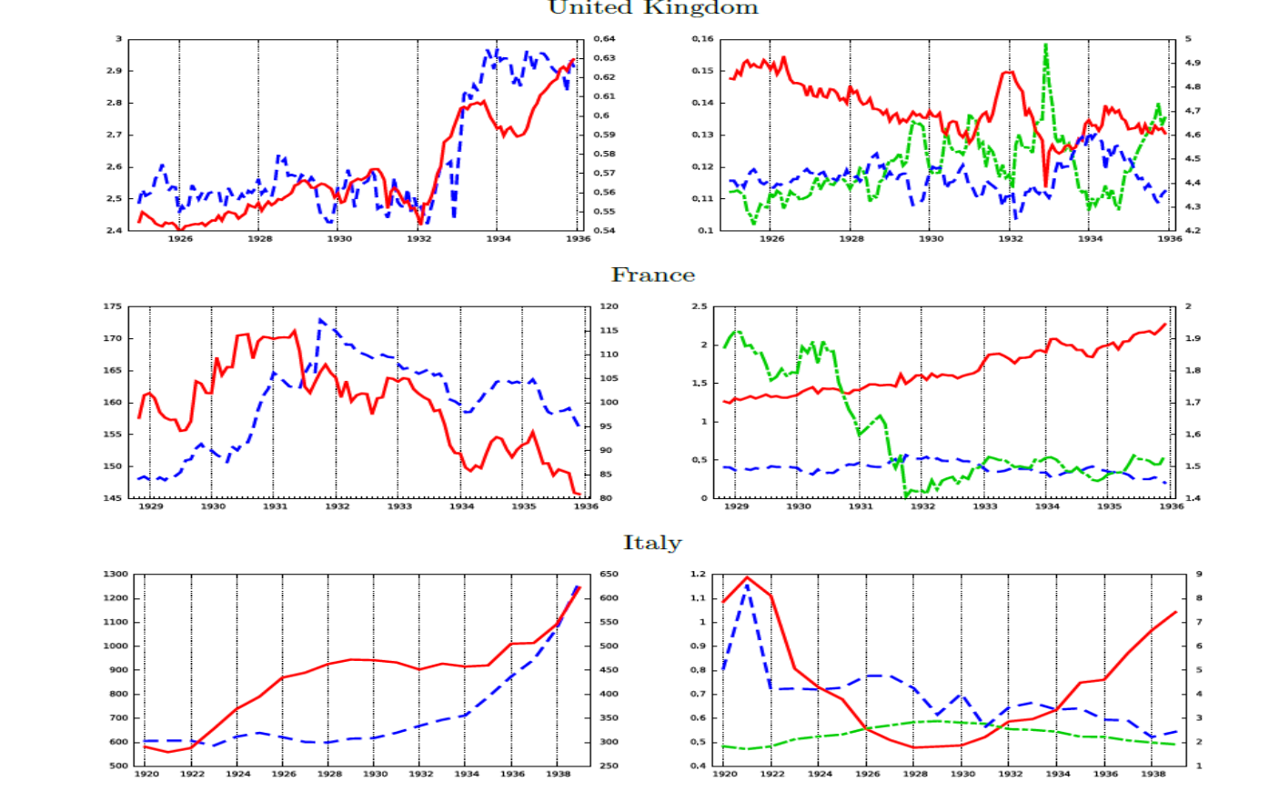

Slide 29
CENTRAL BANKS HAVE LEARNED
After Lehman, the money stock continued its trend in the United States and did not decline in the Eurozone, despite the collapse of the money multiplier
The monetary authorities had learned the lesson of the 1930s: they were bold in creating monetary base at unprecedented rates.
Unlike in the 1930s, the movement of the money multiplier cannot be ascribed to changes in the k ratio, but in the r ratio. Part of the reason for the behavior of r had to do with the deleveraging process that was forced on banks due to collapsing asset prices. Another reason stems from rising counterparty risk, which was putting a lot of sand in the wheels of the interbank market, a discussion we don’t pursue in this presentation.

Slide 30
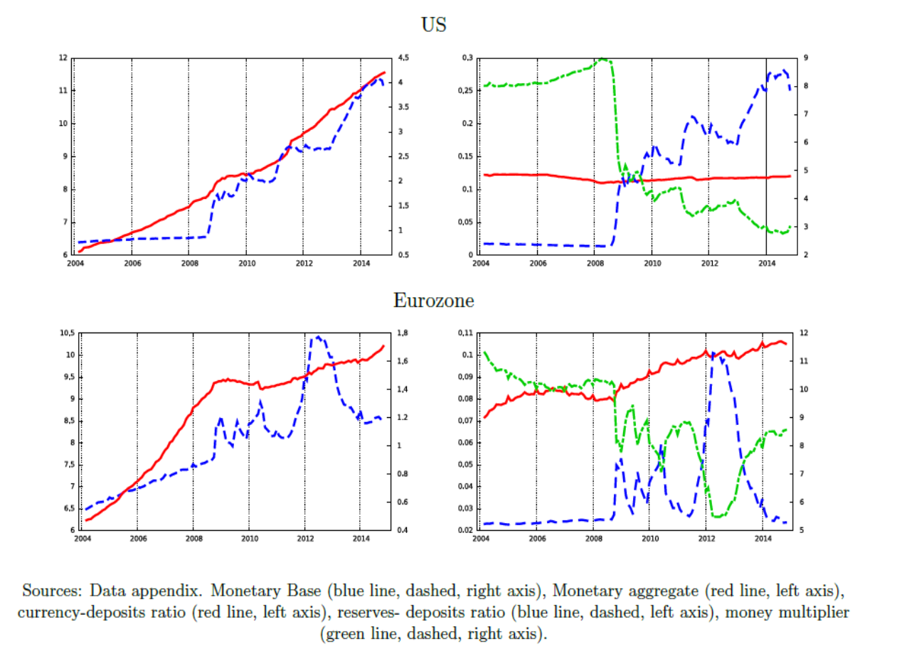

Slide 31
CONCLUSIONS
Similarities between the two crises
Expansive policies were followed by sharp reversals in both great crises.
The price-specie flow mechanism has worked in the wrong direction.
Sudden arrests of capital flows precipitated balance-of-payments crises and deflationary macro adjustments under the two fixed exchange rate regimes.
International cooperation could have prevented a deflationary bias due to asymmetric adjustments to external imbalances.
The role of banks in the two crises has similarities and dissimilarities. The similarity is that a banking crisis, regardless of the timing, has a big impact on the real economy. The difference is in the timing of crises in relation to the output collapse.

Slide 32
Differences between the two crises
Bank failures in the 1930s led the public to raise his cash holdings with contracting consequences on the money stock. In the GFC, the currency-deposit ratio stayed flat because of the protection of deposit insurance.
In the 1930s, monetary authorities either failed to counteract the collapse of the money multiplier with sufficiently large injections of monetary base or failed to understand the process of money creation. Either way, it is a gross negligence. No such a negligence has occurred in the GFC.

